Slide 1

THE MUSMUSCULUS Project Synopsis Presentation Date: 30/11/2024
Industrial Training Seminar(IDS754)
Degree : <B.Tech[(CSE With Data Science), I-Nurture]>
Project Guide:
Vartika Gupta
Manas Chauhan(TCA2166012)
Ali Faiz(TCA2166003)
FACULTY OF ENGINEERING & COMPUTING SCIENCES
TEERTHANKER MAHAVEER UNIVERSITY, MORADABAD

Slide 2

Team Details
Student Name | Role
Manas Chauhan | Data Processing, EDA, Feature Selection
Ali Faiz | Model Training, Model Evaluation, Interpretation
Guidelines: Mention Team Names & their role in project
2
T011A/ Template Version 5.0

Slide 3
Project Brief
THE MUSMUSCULUS
The MUSMUSCULUS project focuses on classifying mice into eight distinct classes based on genotype, behavior, and treatment, using advanced bioinformatics and machine learning techniques. It aims to identify subsets of discriminant proteins that differentiate these classes, contributing to the understanding of genetic and environmental influences on biological systems.
The project utilizes a comprehensive dataset of proteomic expressions across multiple mouse groups, analyzed with classification algorithms to reveal patterns and insights. Outcomes include the identification of key protein markers, providing potential applications in biomedical research, genetic studies, and personalized medicine.
This innovative approach bridges computational biology and experimental genetics, offering a scalable model for future applications in research and therapeutic development.
Guidelines: Mention brief about the project and it’s functions/ modules
3
T011A/ Template Version 1.0

Slide 4
Methodologies/ Technologies/ Tools to be used
Methodologies:-
Data Preprocessing: Handling missing values, normalization, and scaling of proteomic data.
Feature Selection: Identifying discriminant proteins using statistical tests and machine learning algorithms.
Classification: Applying supervised learning techniques (e.g., SVM, Random Forest) for mouse class prediction.
Validation: Cross-validation techniques to ensure model reliability and accuracy.
Technologies:-
Programming Languages: Python for data analysis and modeling.
Machine Learning: Scikit-learn, TensorFlow for classification and pattern recognition.
Bioinformatics Tools: Tools for proteomic data analysis and visualization.
Tools:-
Data Analysis: Pandas, NumPy for data manipulation and analysis.
Visualization: Matplotlib, Seaborn for graphical insights.
Integrated Development Environment: Jupyter Notebook for coding and debugging.
4
T011A/ Template Version 1.0

Slide 5
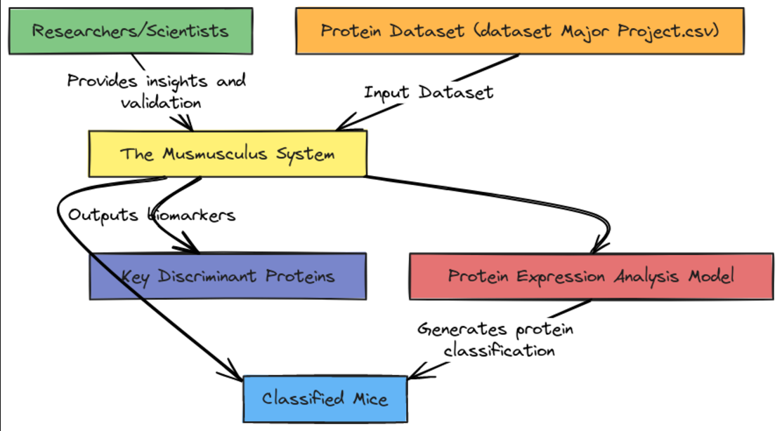
Context Diagram (Overall Project)
5
T011A/ Template Version 1.0

Slide 6
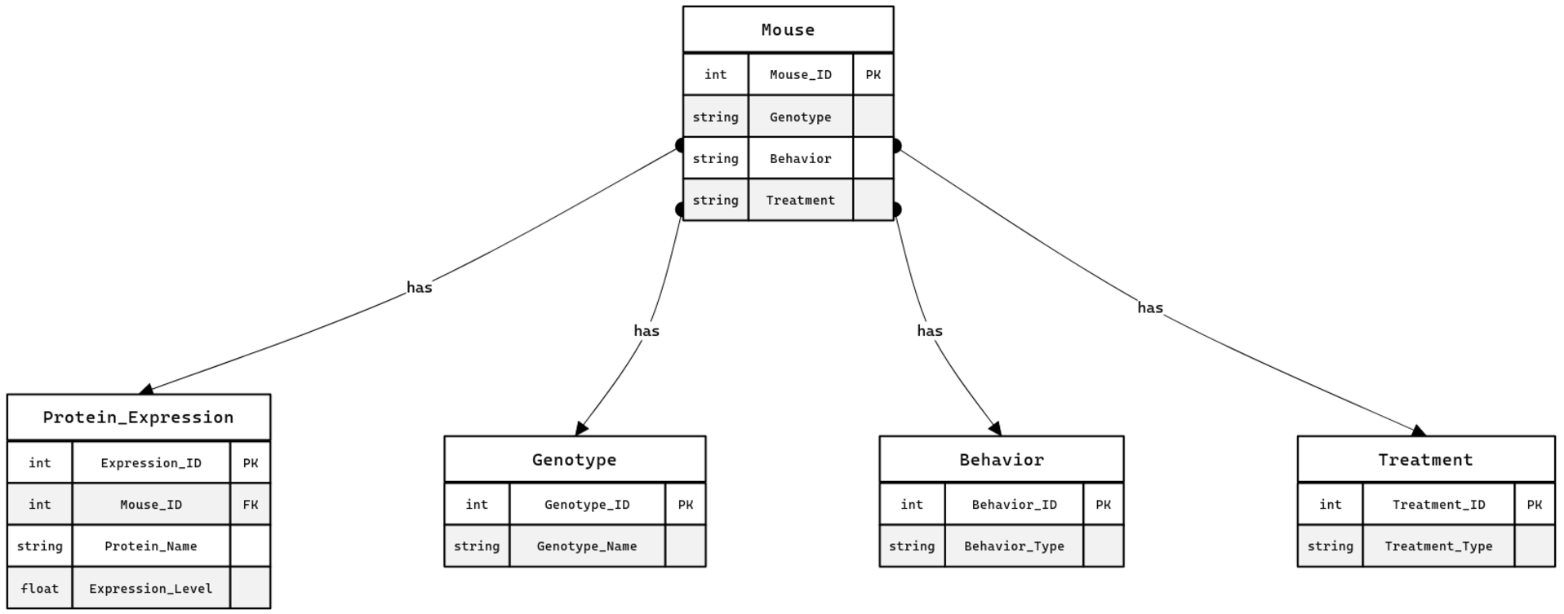
Entity Relationship Diagram (ERD)
6
T011A/ Template Version 1.0

Slide 7
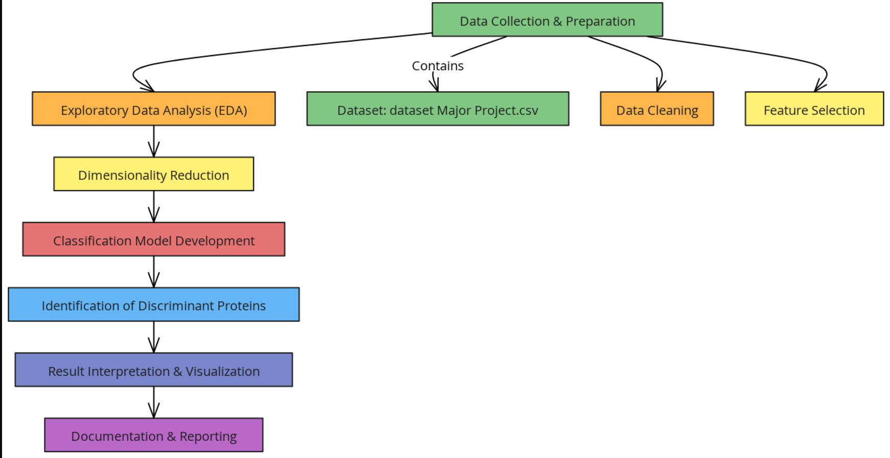
Data Flow Diagram (DFD)
Guidelines: Add more slides, if required to show all DFDs
7
T011A/ Template Version 1.0

Slide 8
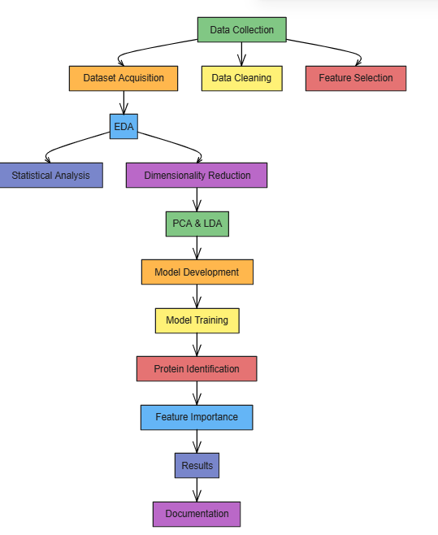
Flow Chart
Guidelines: This slide is optional
8
T011A/ Template Version 1.0

Slide 9
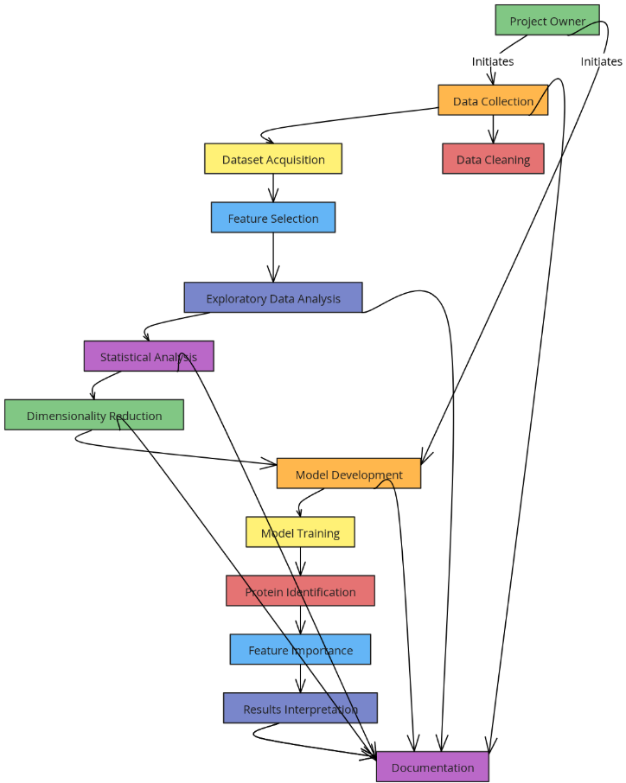
Use Case Diagram
Guidelines: This slide is optional. May add more slide, if the details are available
9
T011A/ Template Version 1.0

Slide 10
\
Advantage of The Project
Identifies Key Proteins: Helps discover proteins that reveal differences in mice based on genetics, behavior, and treatment.
Accurate Classification: Classifies mice into distinct groups more accurately using protein data.
Data-Driven Insights: Uses data analysis to find hidden patterns in protein expression.
Faster Research: Automates classification, speeding up research and saving time.
Broad Impact: Useful for genetics, pharmacology, and behavioral studies.
Predictive Power: Helps predict biological traits based on protein data.
Reliable Results: Ensures results are consistent and reliable through cross-validation.
Guidelines: Mention advantage from this project, the audience/ users who will get benefitted
10
T011A/ Template Version 1.0

Slide 11
References, if any
www.evoastra.com
www.google.com
11
T011A/ Template Version 1.0

Slide 12



THANKS

